Slide 1




Slide 2
Determining Concurrency via WA Logs Method

Slide 3

Concurrency the measurement of simultaneous requests made into a service or resource. Concurrency is typically an important measurement for high volume applications as compute or network capacity can become constraints.
Watson services run in containers with access to finite compute resources. Each request that comes into the service is addressed until the container reaches capacity. For customers of Premium Watson services there is a standard baseline of concurrency offered. Additional concurrency can typically be purchased if the use case requires.
What is Concurrency?

Slide 4
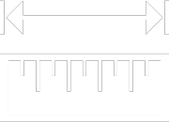
Each service may have a unique API unit of measurement. Assistant for example simply measure’s raw “API calls” regardless of the contents of the request. Speech to Text on the other hand measures usage by the minute and Text to Speech by the character.
Concurrency for each service is discreet from other services. 15 API calls to Assistant at 12:00PM and 15 requests to Text to Speech at the same time do not equal 30 concurrency.
To measure concurrency for Assistant we must have a time stamp for every request made into the service. We then add the number of request for each minute to determine concurrency.
How is Concurrency Measured?

Slide 5
Pull the logs using the logs method. Additional detail here: https://cloud.ibm.com/apidocs/assistant#list-log-events-in-a-workspace This method will require that you have the following information for your production Watson Assistant workspace. - Credentials (Username and Password or API key)
Workspace ID
Example request with CURL:
curl -u "apikey: a65Jg77tbXali0WEWOn5kimmC0” https://gateway.watsonplatform.net/assistant/api/v1/workspaces/3b60f77d-2067-41fa-f4d5a1ac57e/logs?version=2018-09-20
Step 1.
Get data using “logs” method
Notes:
Sample CURL
curl -u "apikey:1uHaTbumtbkama65Jg77tbXKKpgxali0WEWOn5kimmC0" "https://gateway.watsonplatform.net/assistant/api/v1/workspaces/3b60f77d-2067-41fa-9218-0f4d5a1ac57e/logs?version=2018-09-20"

Slide 6
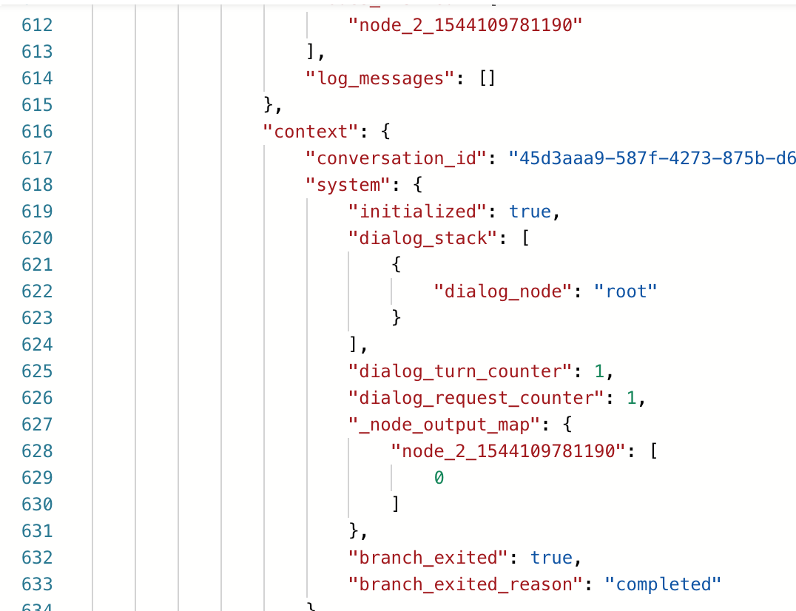
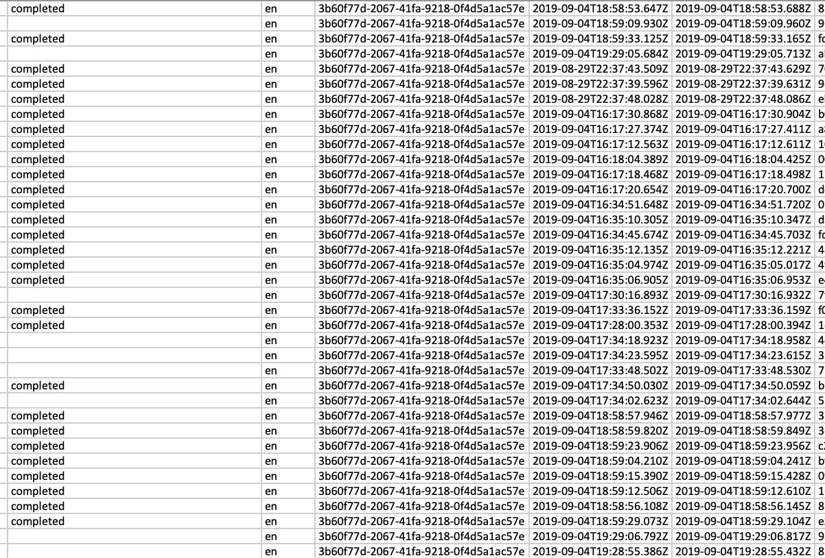
The log method returns a JSON file with detailed data on all requests made into your instance , including the time stamps.
In order to calculate the concurrency this JSON needs to be converted to spreadsheet form or other consumable format.
This can be done with a simple web tool: http://www.convertcsv.com/json-to-csv.htm * or
Using an automated workflow in Watson Studio with a notebook https://cloud.ibm.com/catalog/services/watson-studio
* Tools on the public internet may not be suitable for sensitive data
Step 2. convert the logs

Slide 7
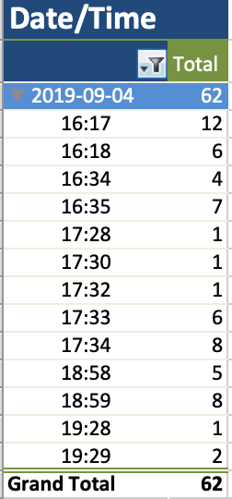
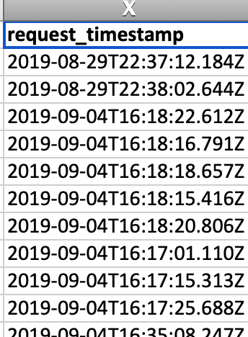
Isolate the “request_timestamp” column/data for each api call
Use a pivot table to surface concurrency
Step 3. Refine the data

Slide 8
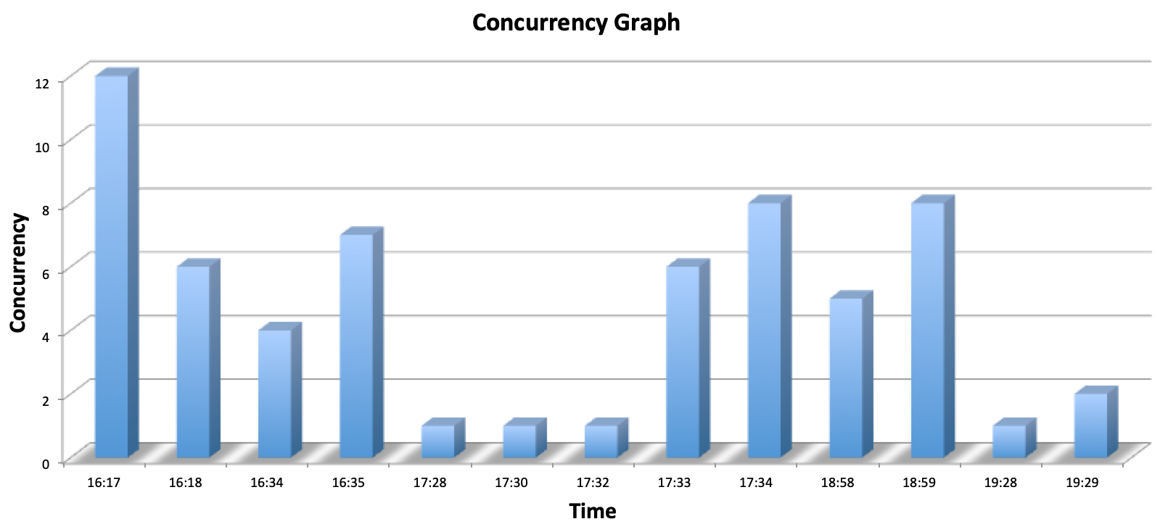
Present the data

